Slide 1
Programming Principles and Techniques
INTRODUCTION TO
COMPUTER
PROGRAMMING
<number> - 15

Slide 2
Learning Outcomes
By the end of this session, you should be able to:
Define the meaning of programming and computer program; and
Describe the steps required for programming processes;
<number> - 13

Slide 3
Introduction
Computer helps people to accomplish tasks easier.
Computer consists of hardware and software.
Software is created using programming languages.
The instructions to hardware must be done through software, and the process of developing the software is called programming.
<number> - 13

Slide 4
Definitions
  Computer program Computer program is a sequential instruction which determines the steps to be taken by a computer.
  Programmer is a person who is in charge of writing a computer program.
  Computer programming is a process to plan a set of sequential instructions to be run by a computer.
<number> - 13

Slide 5
Program Development Process
Programming processes can be divided to two phases:
  The problem solving phase
  The implementation phase
<number> - 13

Slide 6
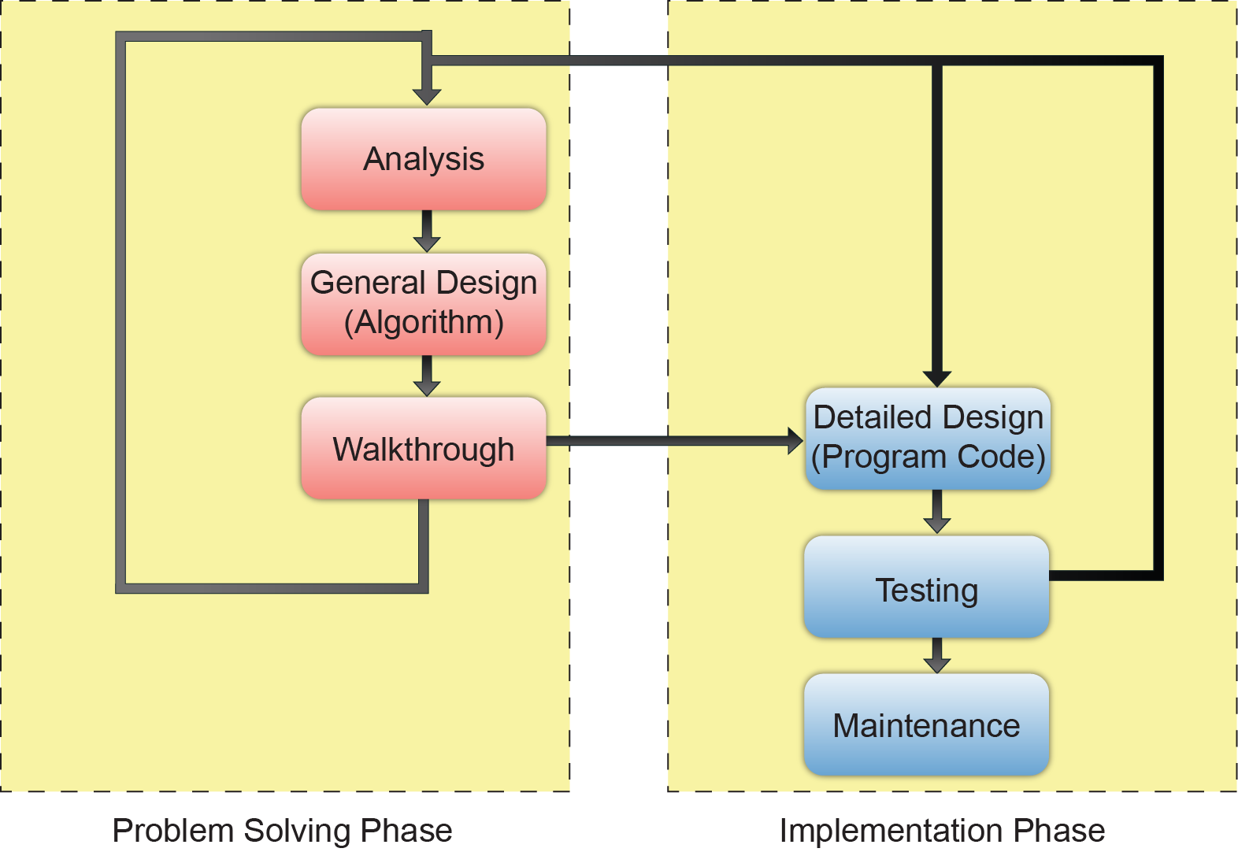
Program Development Process
<number> - 13

Slide 7
Problem Solving Phase
There are three steps to be taken during problem solving phase:
  To perform a problem analysis,
  Create a general algorithm design, and
  Walkthrough the algorithm.
<number> - 13

Slide 8
Analysis
Is a process of understanding and defining a problem.
At this stage, programmer must state the problem clearly and identify the needs to solve the problem.
This part is crucial to be determined because it will influences the next step in the problem solving phase.
<number> - 13

Slide 9
General Design (Algorithm)
Algorithm is a set of logical sequential steps used to solve a problem.
You need to identify three sub-problems:
  Data collection
  Process calculations
  Output results
Once the sub-problem is identified, you can refine the solution one-by-one.
<number> - 13

Slide 10
Walkthrough
This is a process of checking each step of the algorithm to see if the algorithm really does solve the problem.
This process is also called as tracing algorithm.
Use sample of input and check it step-by-step.
If errors are found, fix the algorithm and repeat the processes in this phase until you get a working algorithm.
<number> - 13

Slide 11
Implementation Phase
The implementation phase consists of three steps:
  Program coding
  Code testing
  Program maintenance
<number> - 13

Slide 12
Program Coding
Each algorithm step is interpreted into one or more statements in programming language.
Process of writing code (or called programming) happens at this stage.
Programmer normally follows all instructions stated in the algorithm.
<number> - 13

Slide 13
Code Testing
This is a process of running program and checking for errors.
There are sets of data used to test the program to make sure the program functions well for different situations.
If errors are found, the program must be corrected until it produces the right output.
<number> - 13

Slide 14
Maintenance
This stage is meant for a process of finding errors that could not be found before, and update it according to the current changes needed.
It is important for programmer to write the codes in a very good style of coding so that the other programmers can do the maintenance.
<number> - 13

Slide 15
Summary
Computer programming is a process to plan a set of sequential instructions to be run by a computer.
Computer program is a sequential instruction which determines the steps to be taken by a computer.
Programming process consists of the problem solving phase and the implementation phase.
The problem solving phase consists of analysis works, building algorithm and tracing algorithm.
The implementation phase consists of program coding, program testing and program maintenance.
<number> - 13

